Slide 1
acmASCIS Machine learning Session IV
Abdelrahman Hamdy Ahmed Hany Ibrahim Sharaf

Slide 2
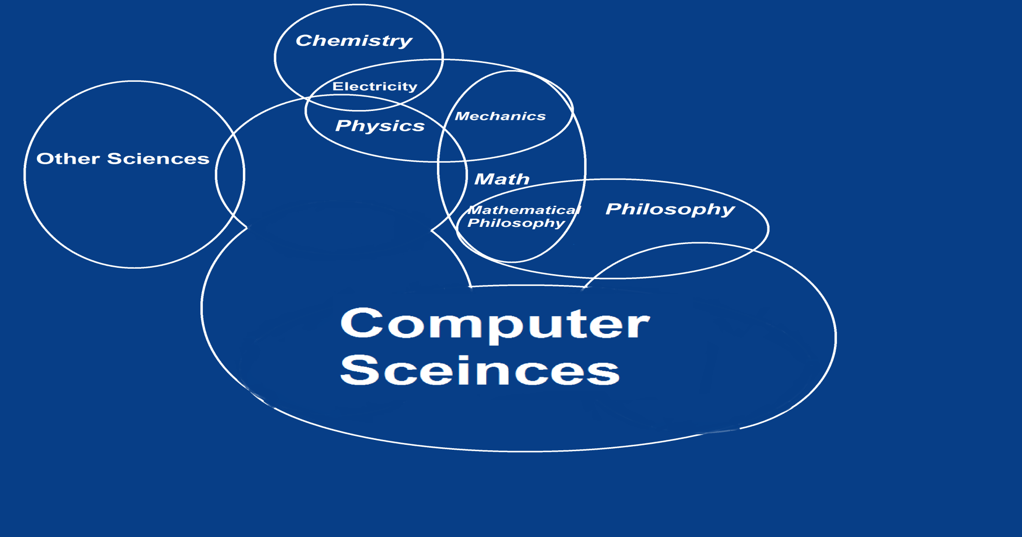
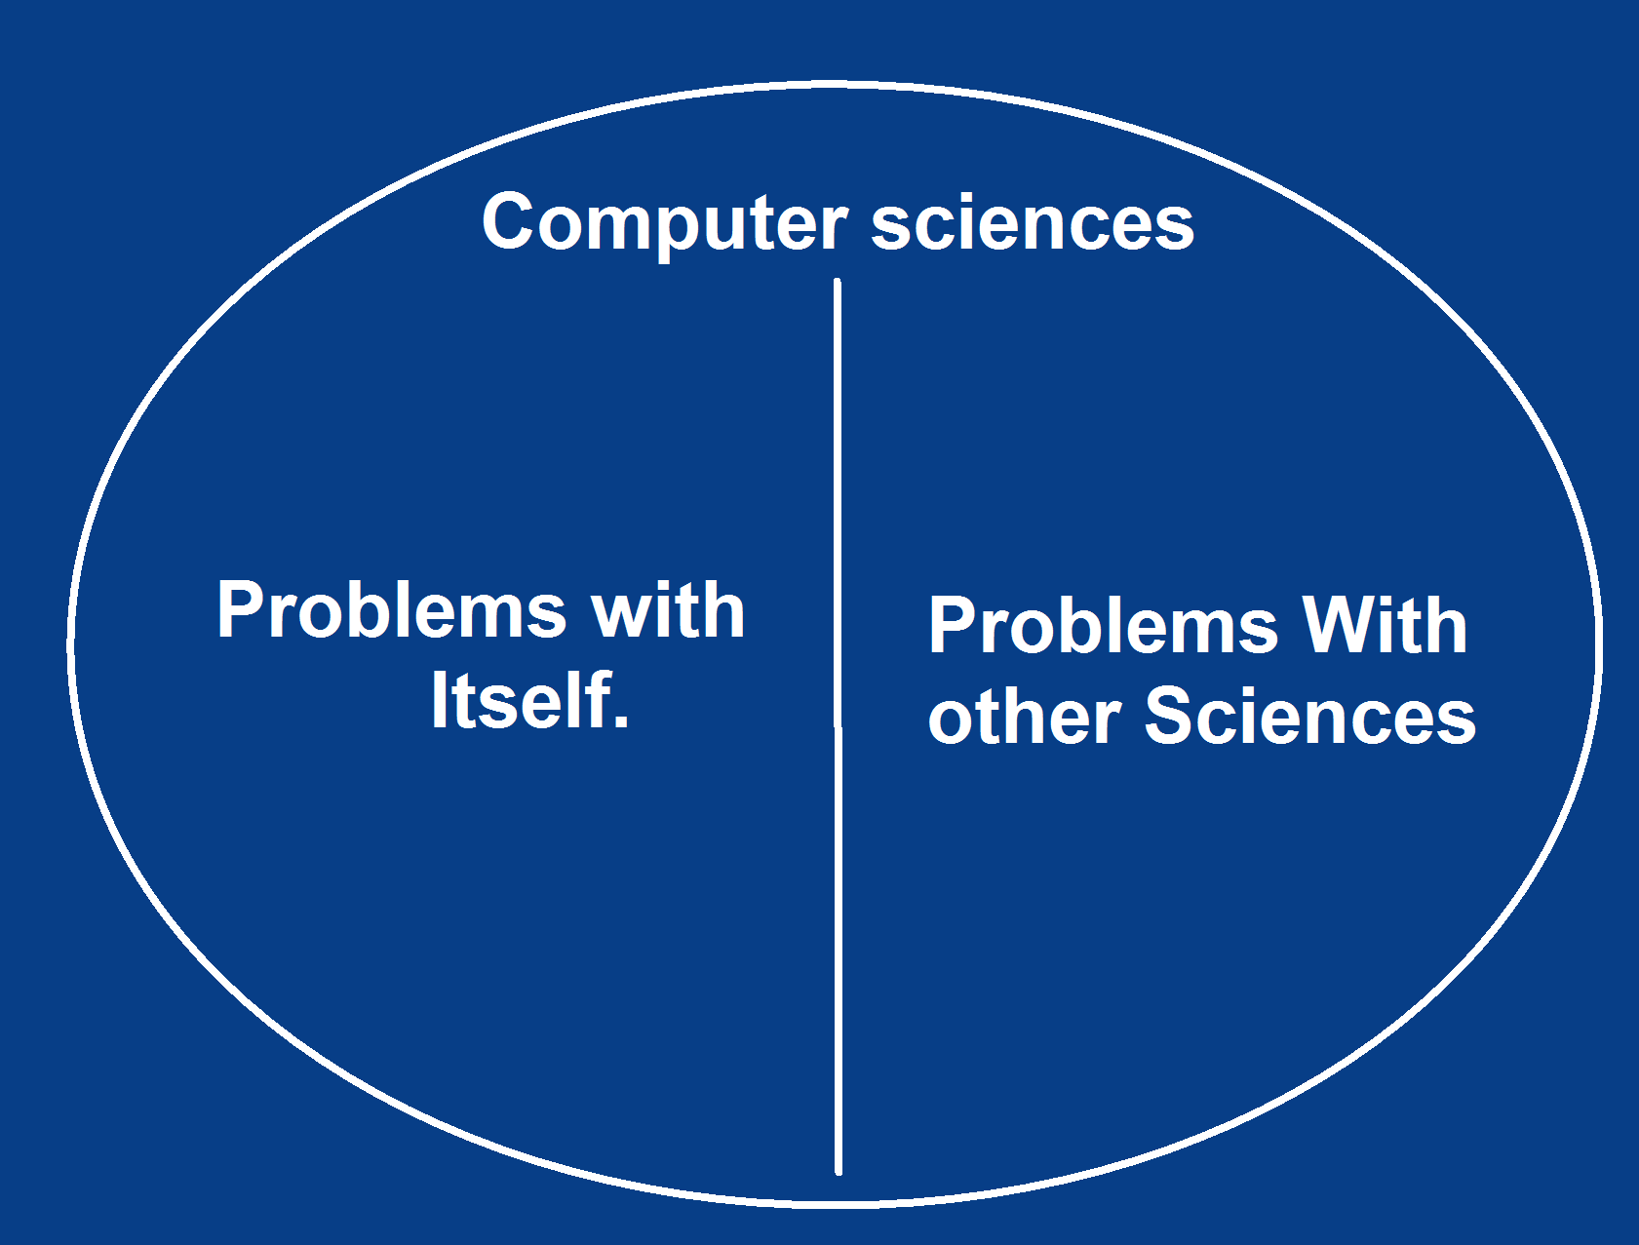
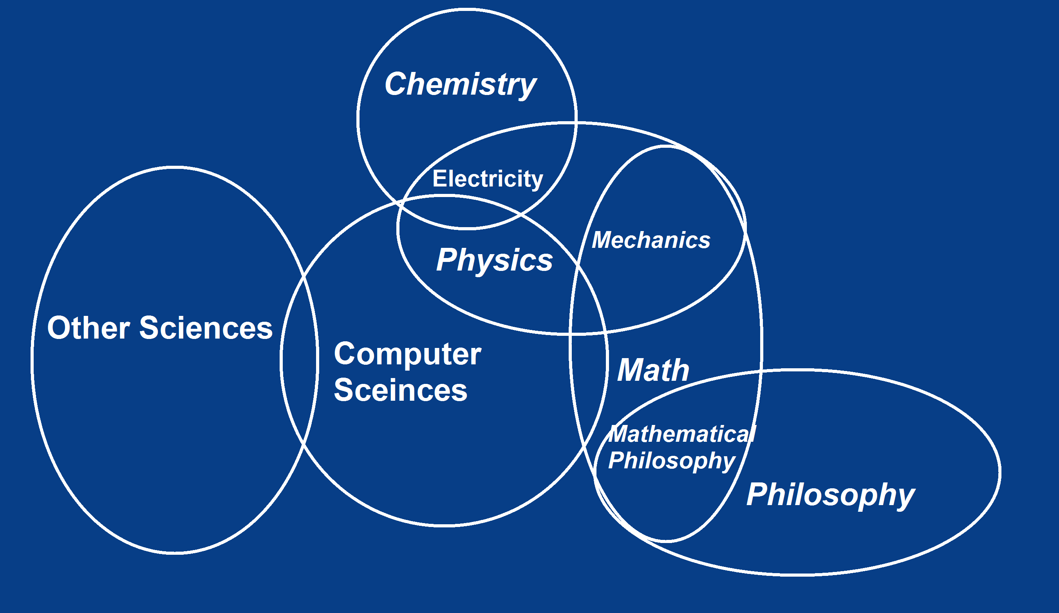
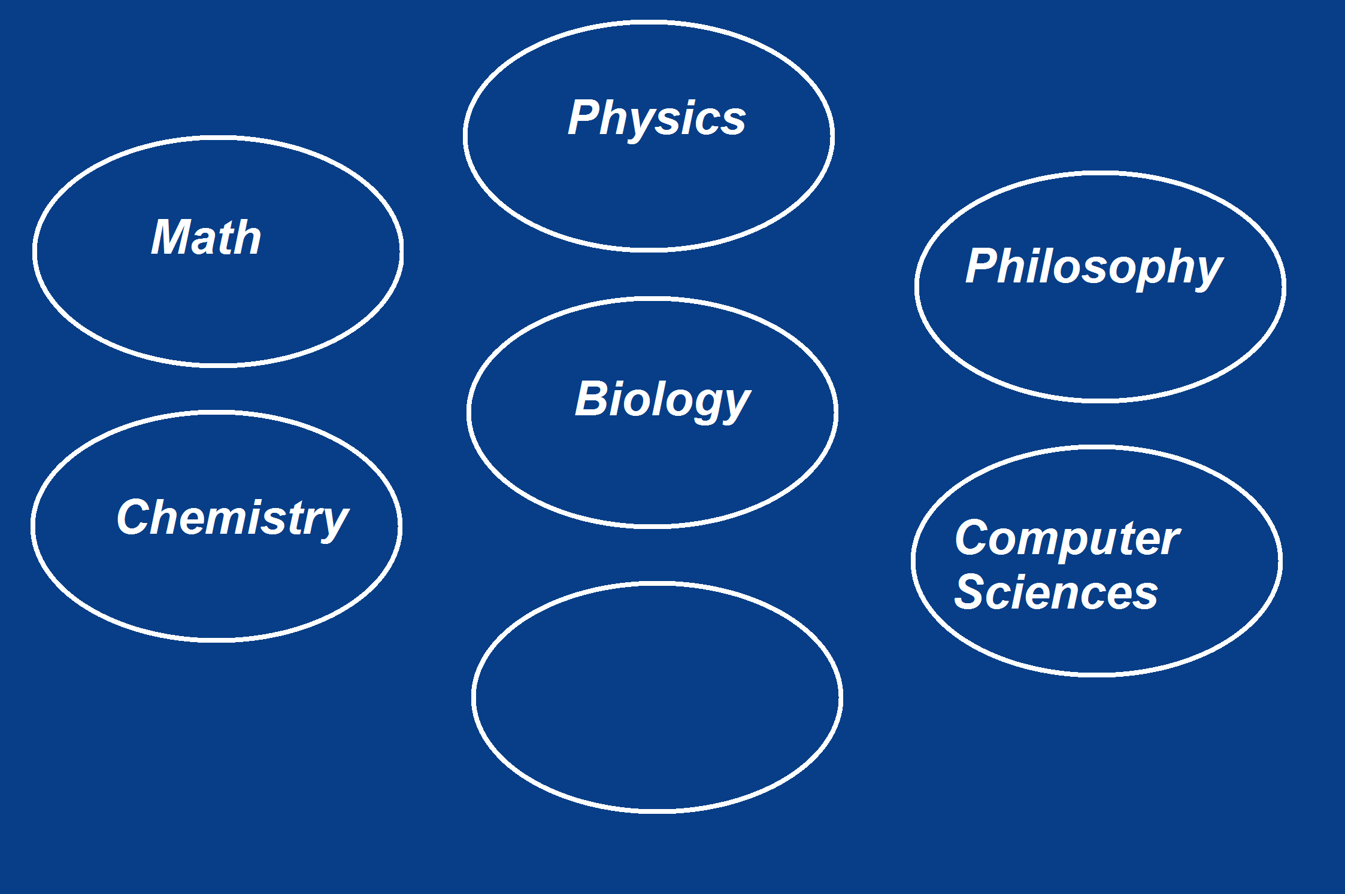
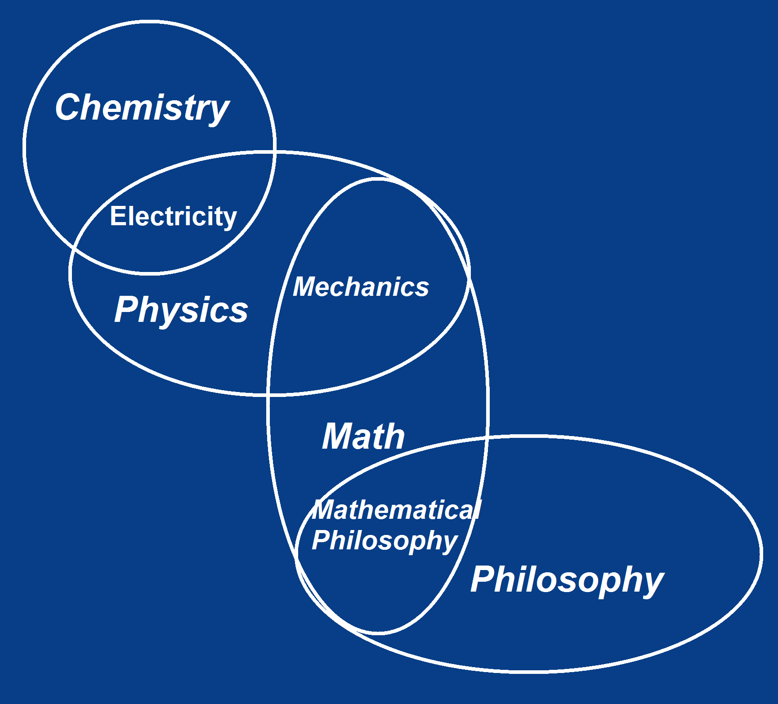
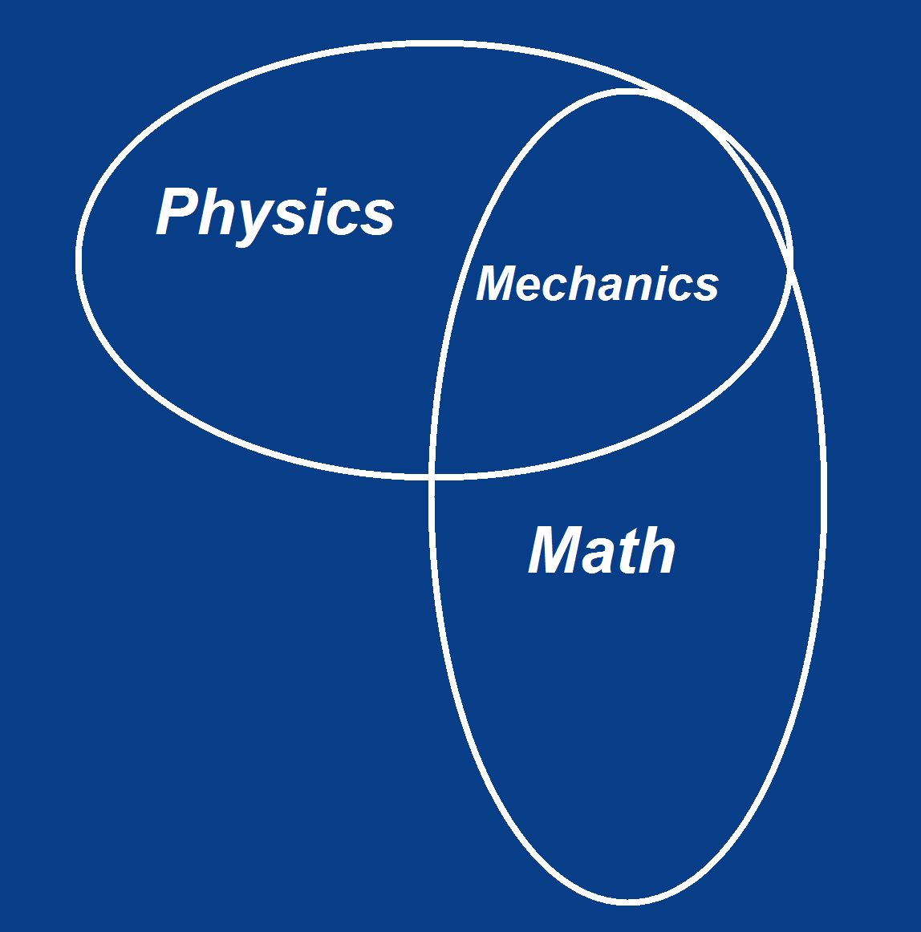
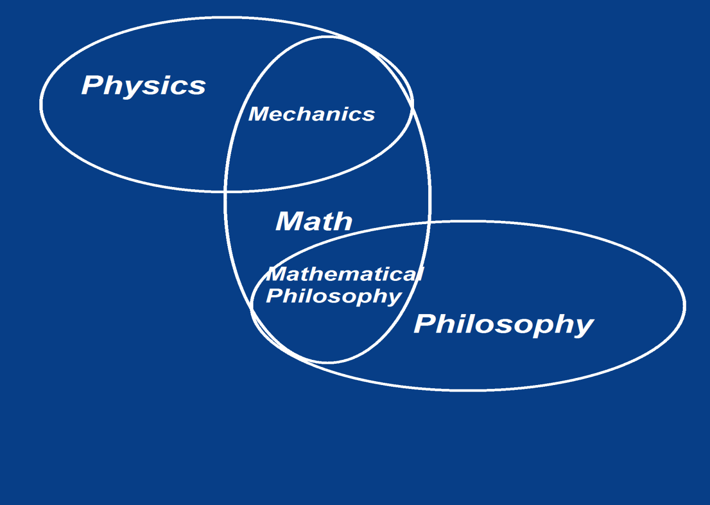
Sciences

Slide 3
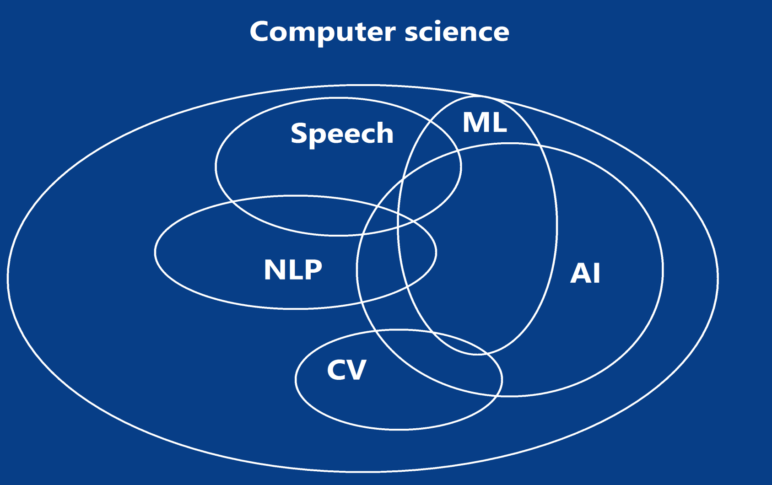
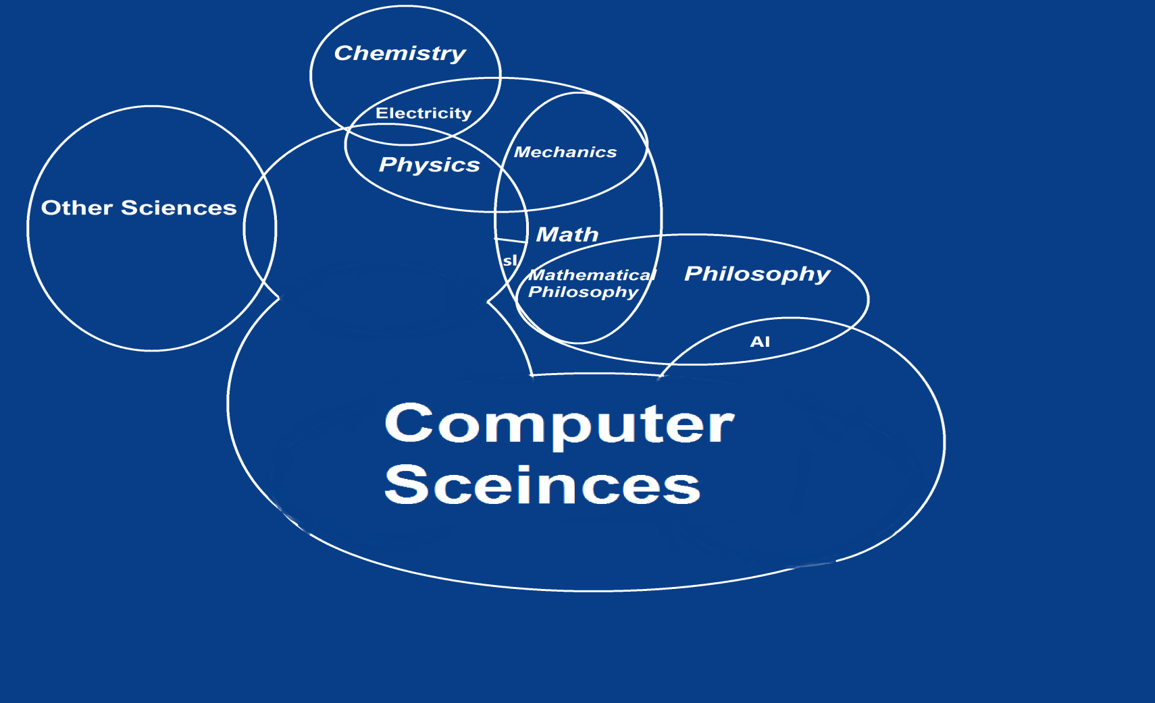
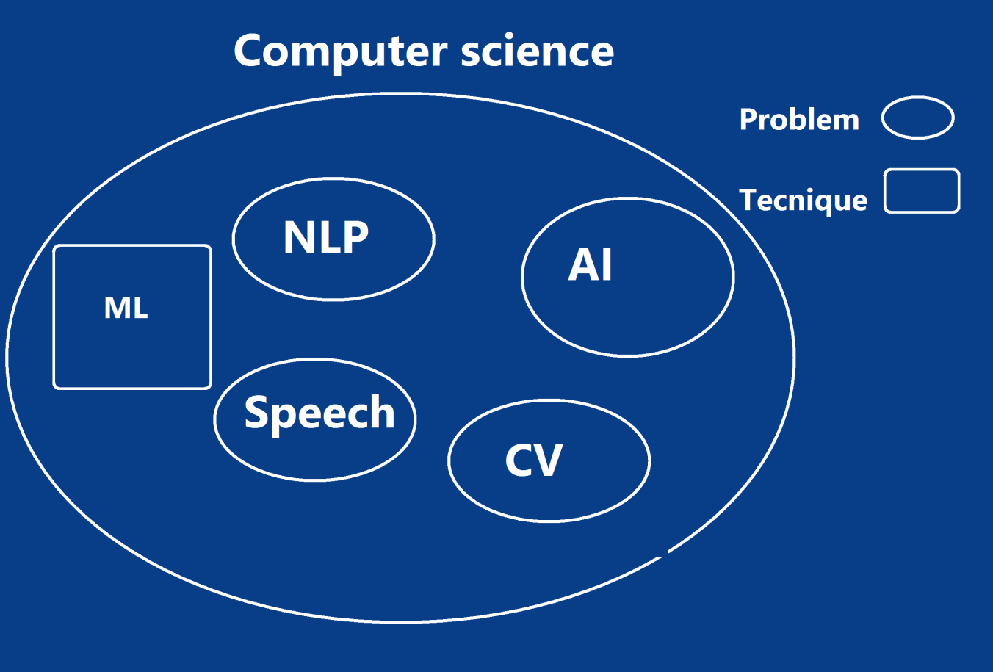
Sciences
Where are us ?

Slide 4
Agenda
Revision.
Neural Networks.
Practice.
Deep Learning.
Practice.
GP – ML.

Slide 5
Agenda
Revision.

Slide 6
Revision
Machine learning Pipeline.
Supervised vs Unsupervised
Linear regression.
Cost function.
Gradient Descent.
Logistic Regression.
OverFitting

Slide 7
Agenda
Revision.
Neural Networks.

Slide 8
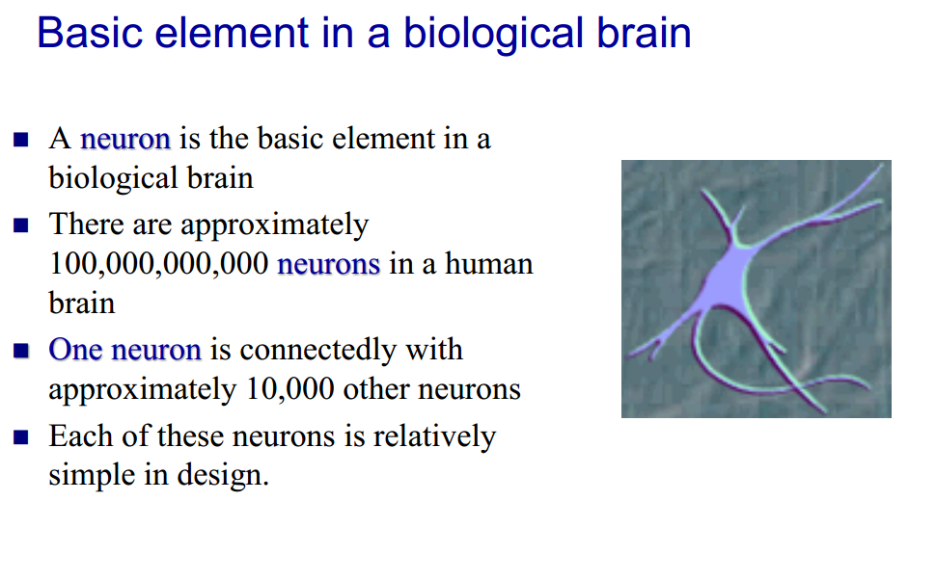
Artificial Neural Networks

Slide 9
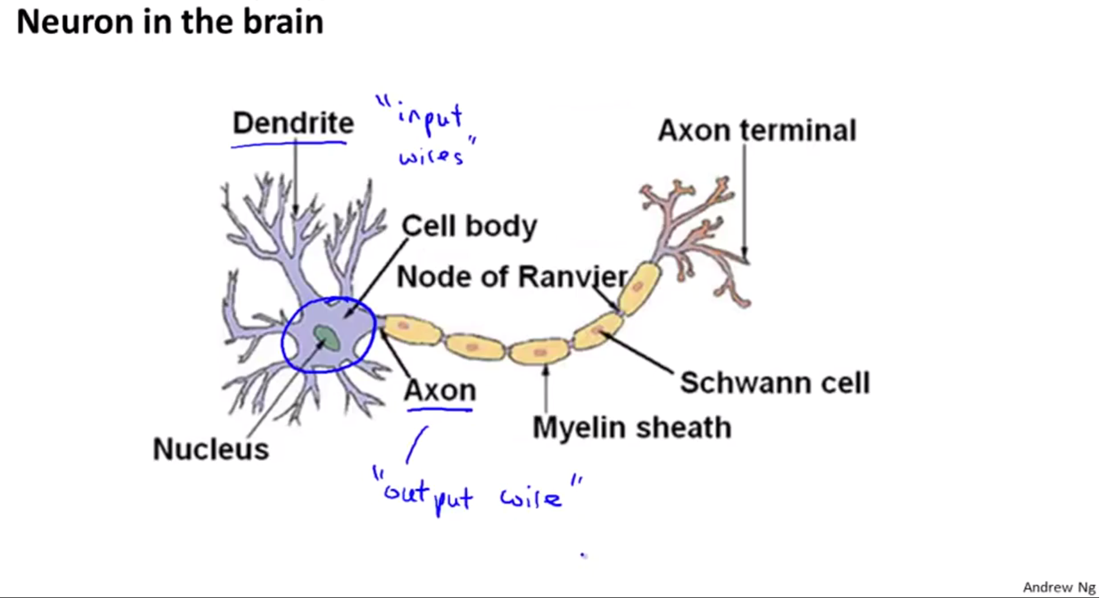
Artificial Neural Networks

Slide 10
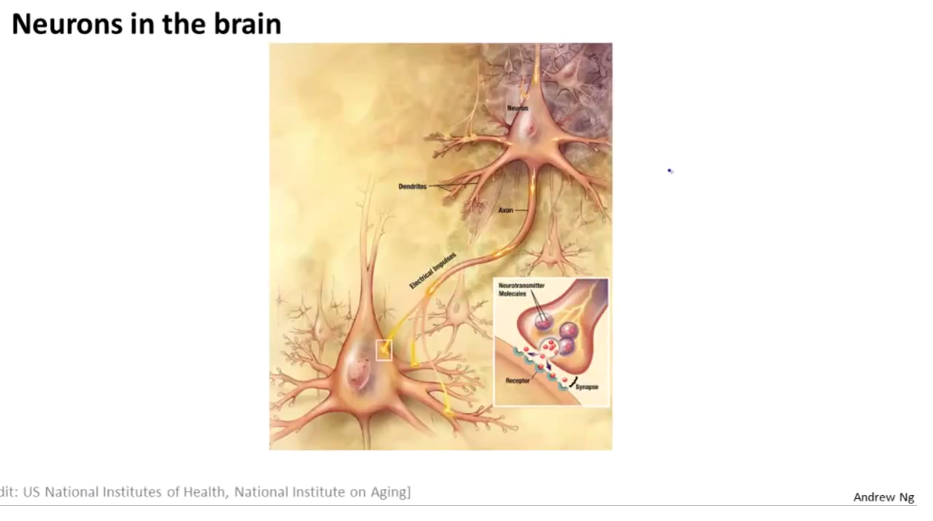
Artificial Neural Networks

Slide 11
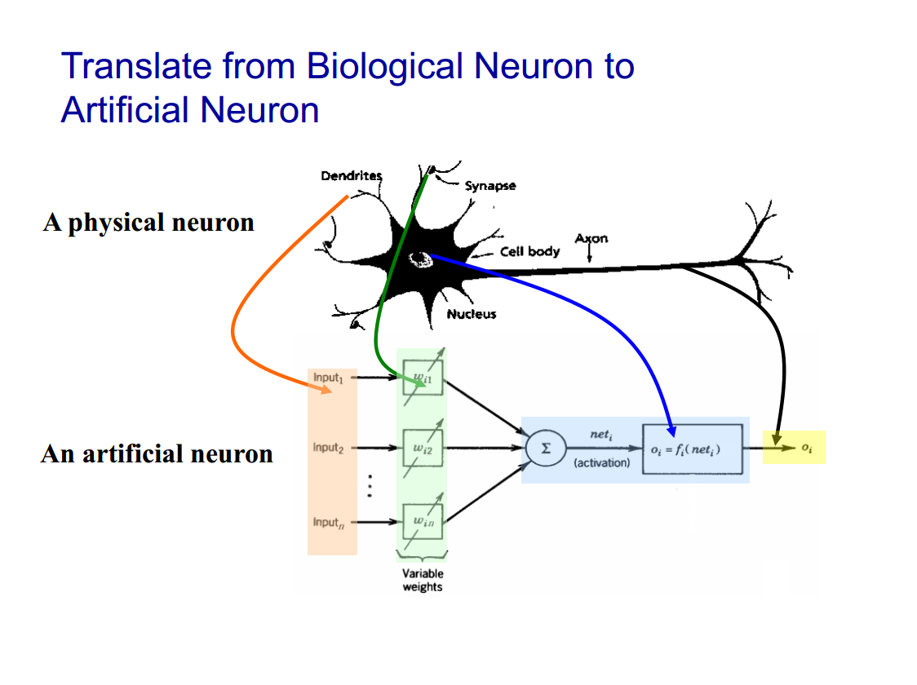
Artificial Neural Networks

Slide 12
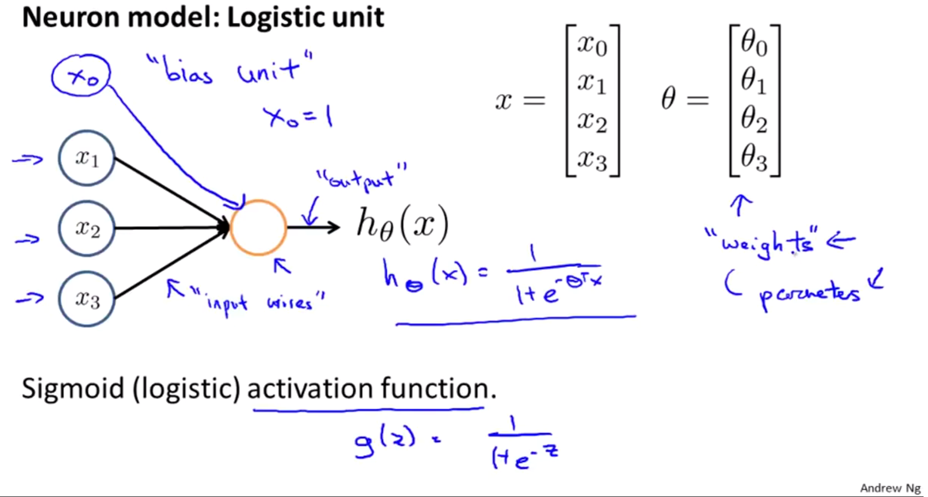
Artificial Neural Networks

Slide 13
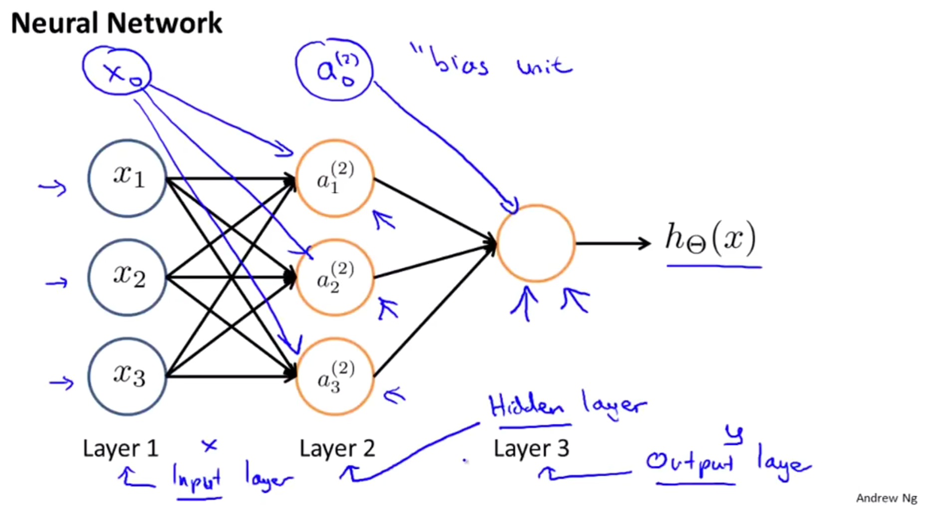
Artificial Neural Networks

Slide 14
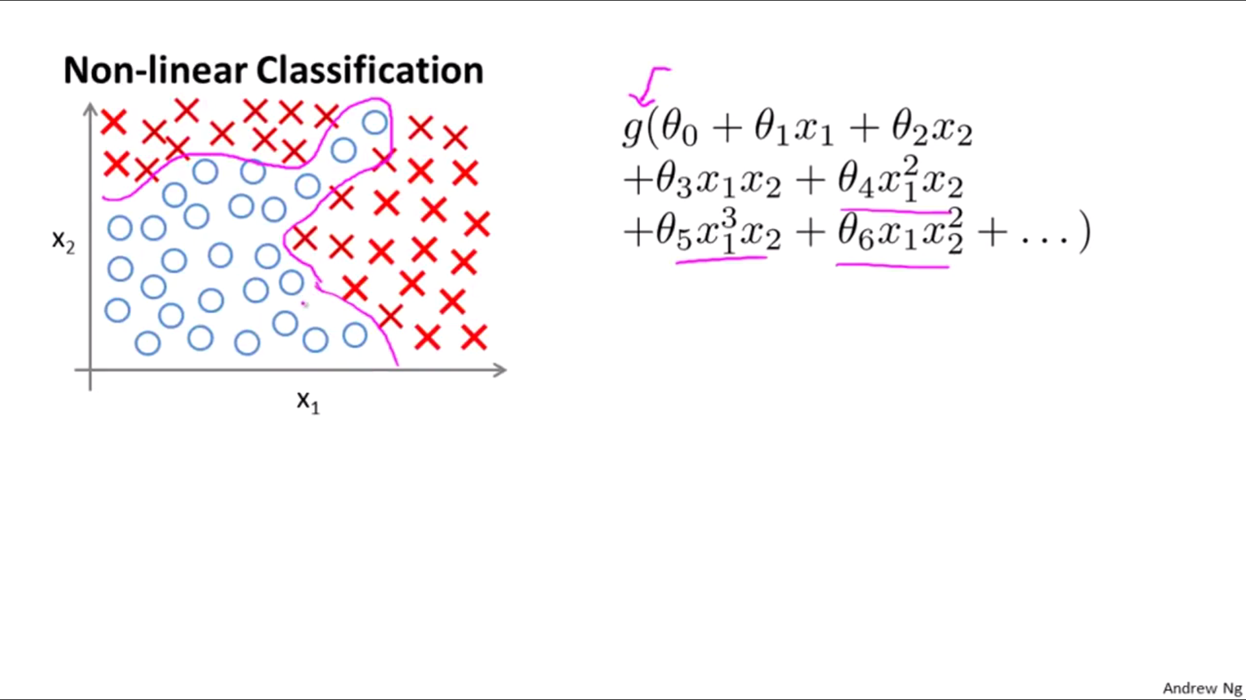
Artificial Neural Networks
Why

Slide 15
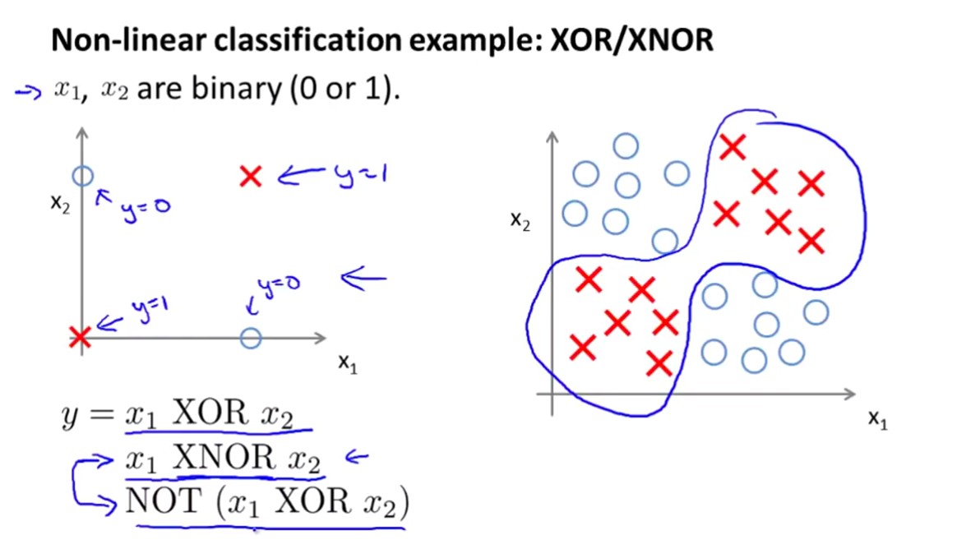
Neural Networks – Why

Slide 16
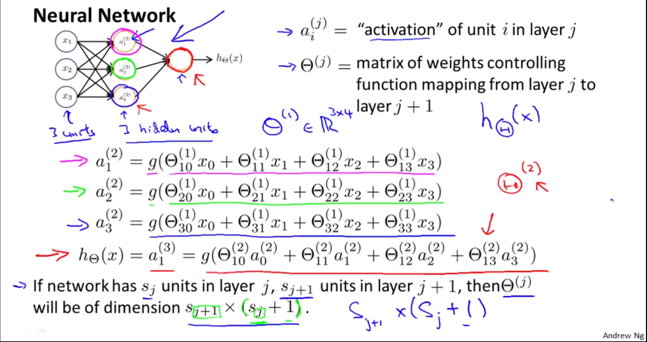
Neural Networks – Why

Slide 17
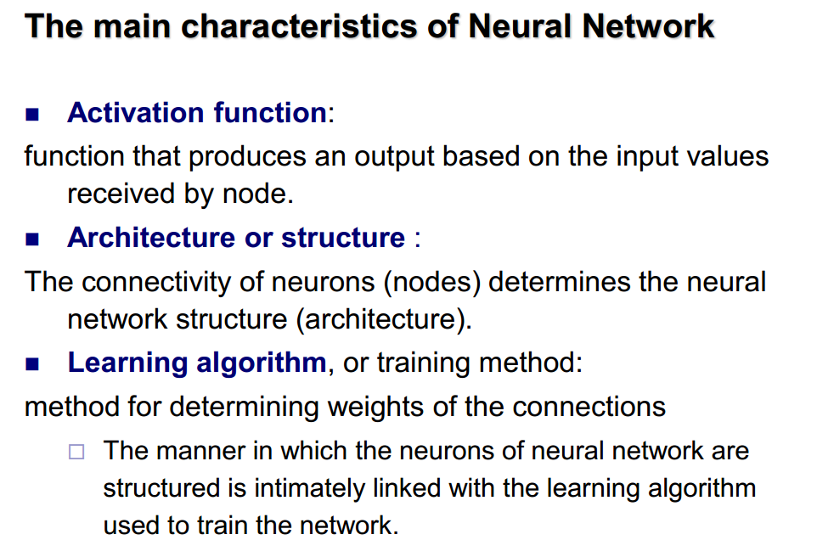
Neural Networks – Why.

Slide 18
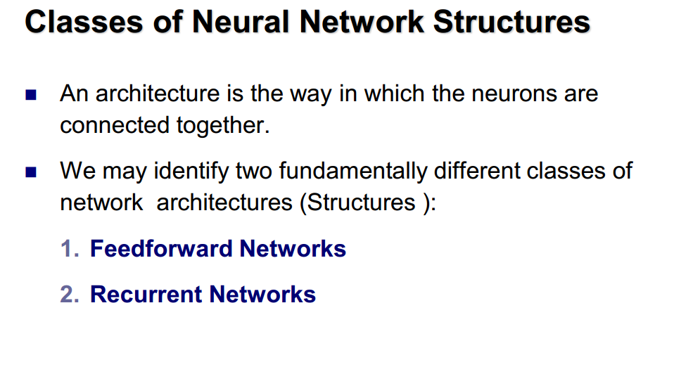
Neural Networks – Why.

Slide 19
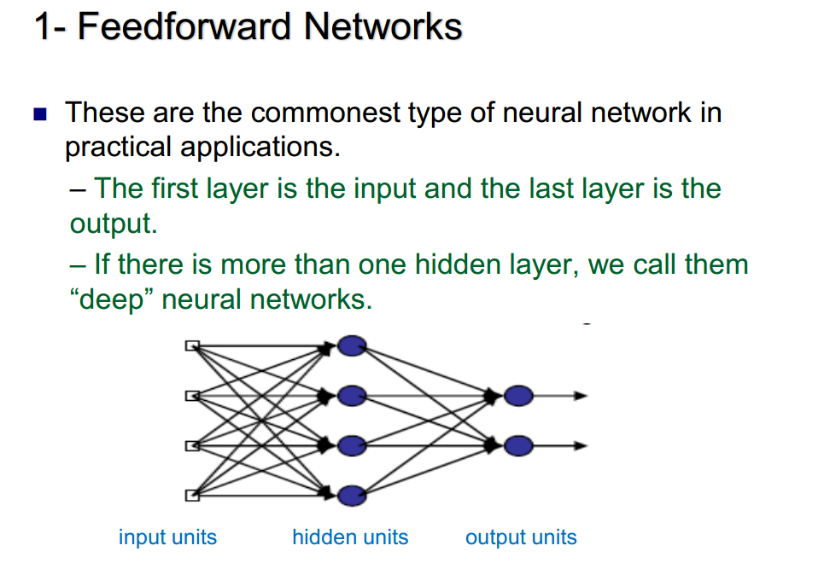
Neural Networks – Why.

Slide 20
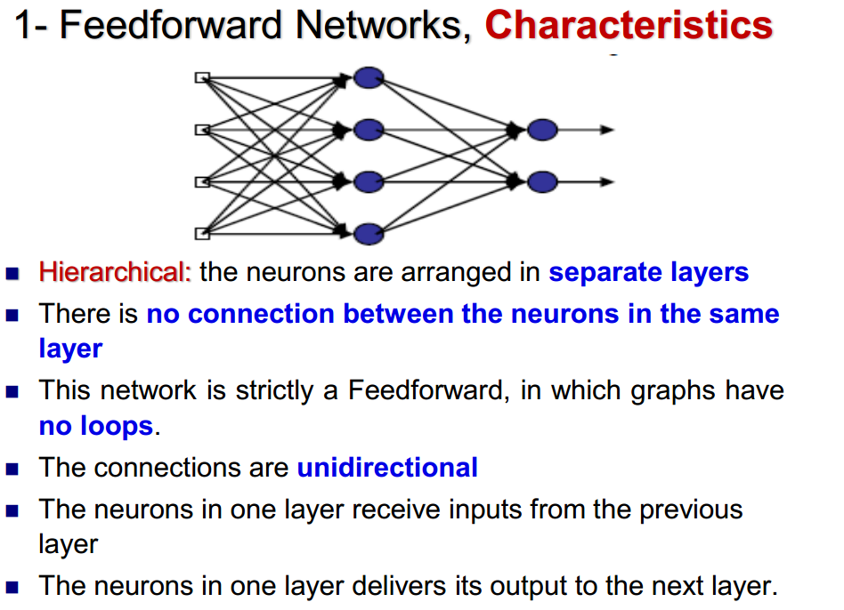
Neural Networks – Why.

Slide 21
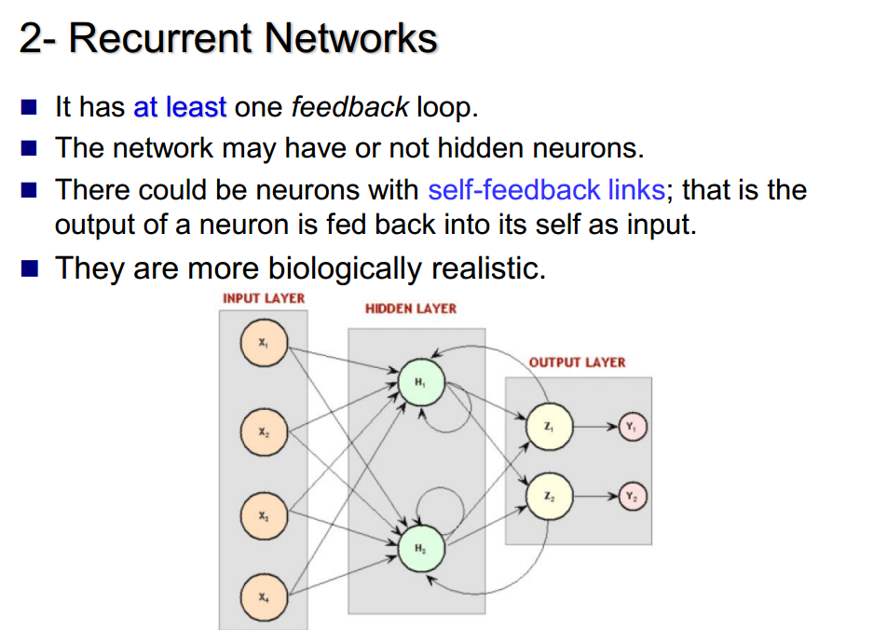
Neural Networks – Why.

Slide 22
Agenda
Revision.
Neural Networks.
Practice.

Slide 23
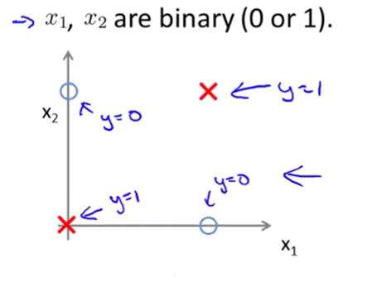
Practice I
XOR Example

Slide 24
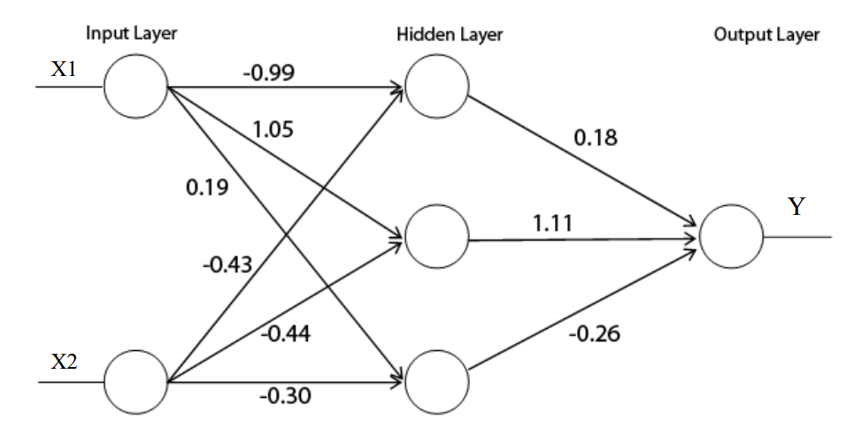
Practice I
XOR Example

Slide 25
Resenblatt’s perceptron

Slide 26
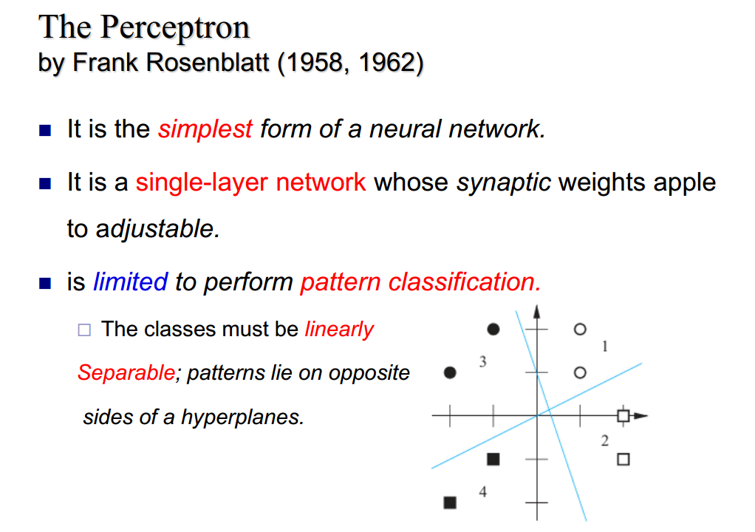
Resenblatt’s perceptron

Slide 27
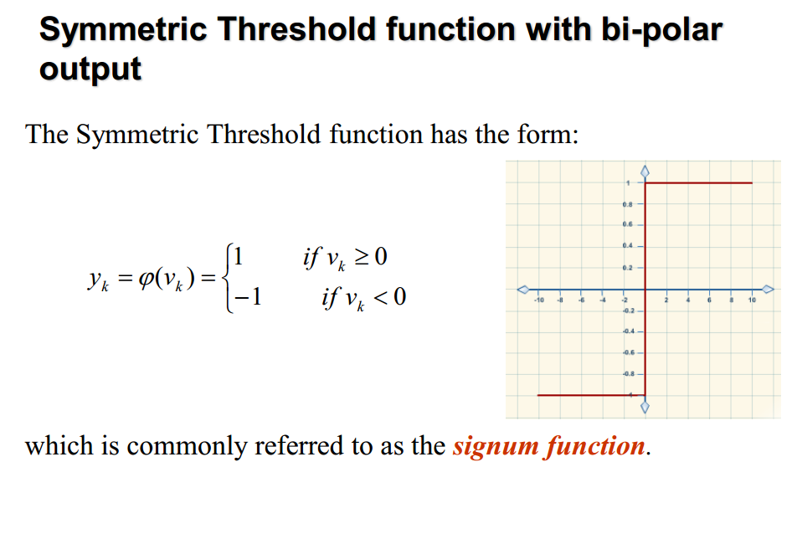
Resenblatt’s perceptron

Slide 28
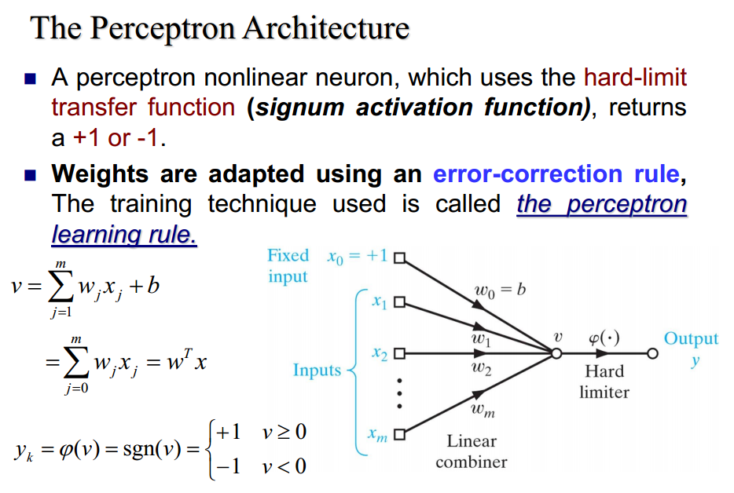
Resenblatt’s perceptron

Slide 29
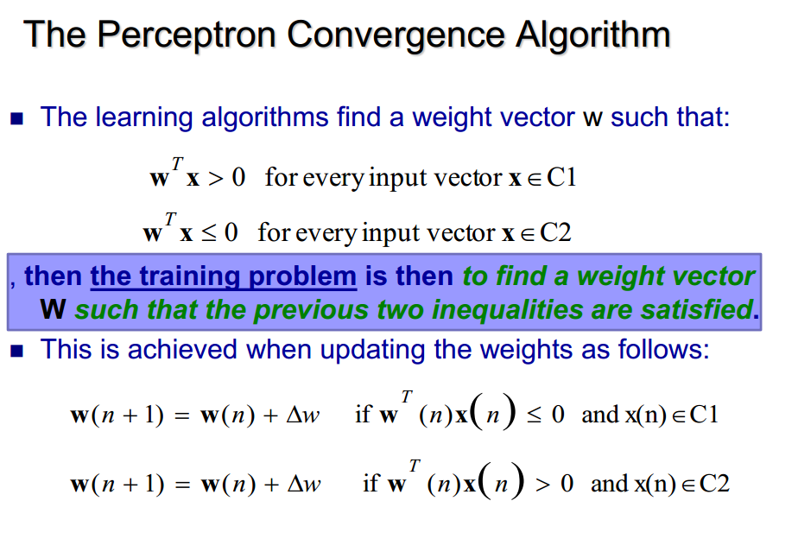
Resenblatt’s perceptron

Slide 30
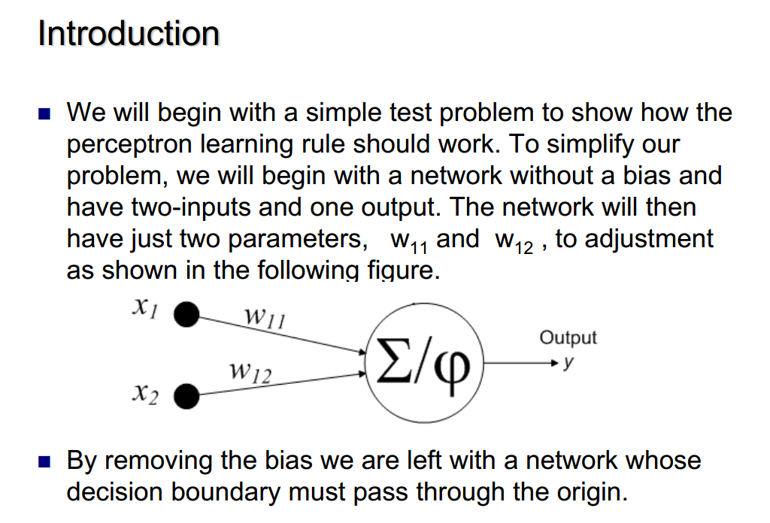
Resenblatt’s perceptron

Slide 31
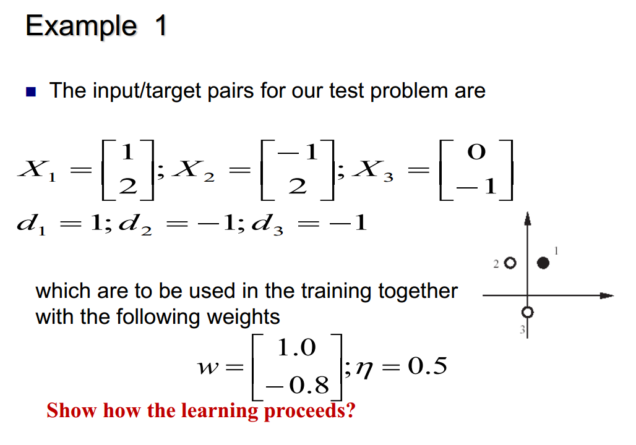
Resenblatt’s perceptron

Slide 32
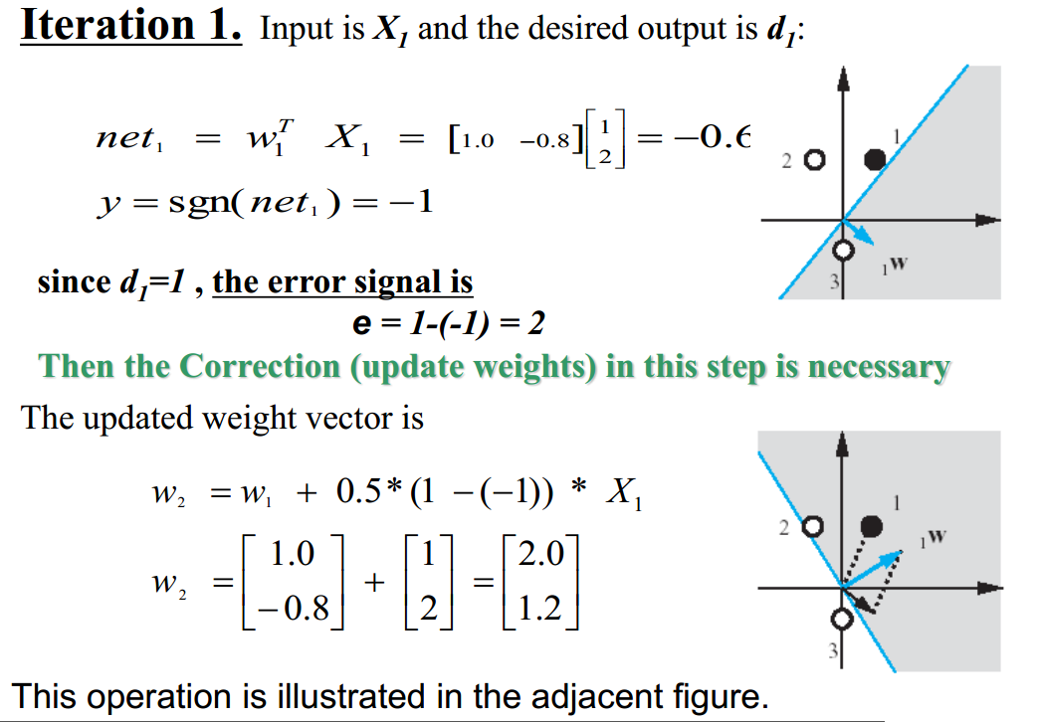
Resenblatt’s perceptron

Slide 33
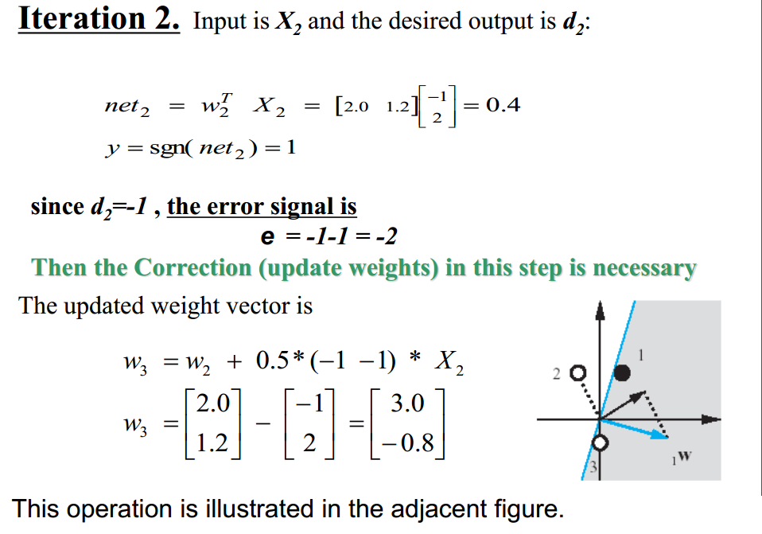
Resenblatt’s perceptron

Slide 34
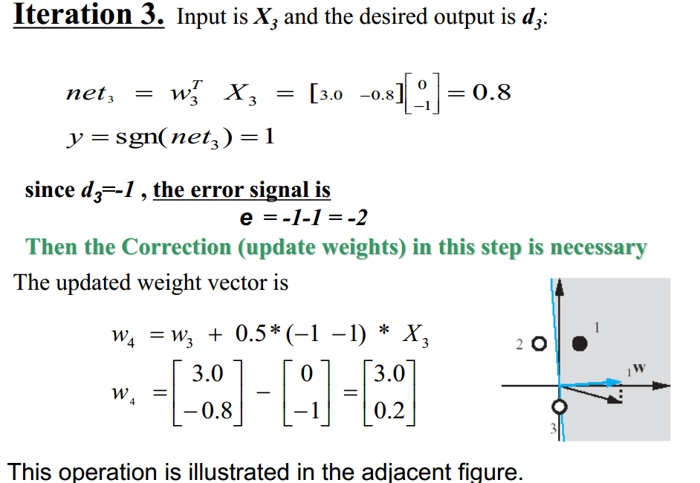
Resenblatt’s perceptron

Slide 35
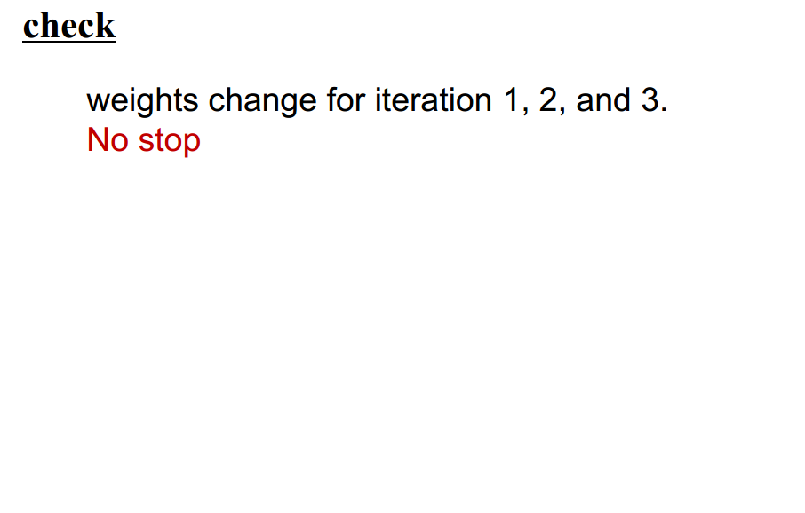
Resenblatt’s perceptron

Slide 36
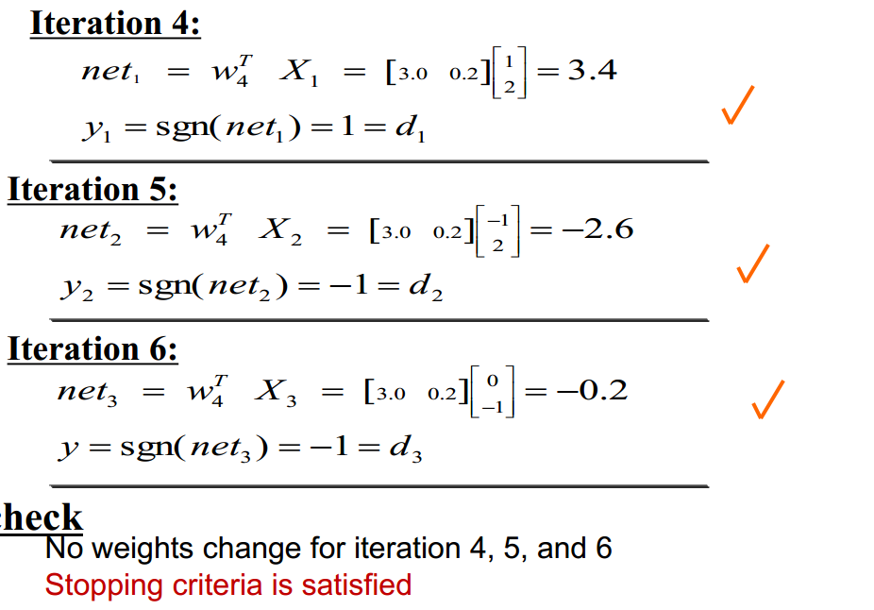
Resenblatt’s perceptron

Slide 37
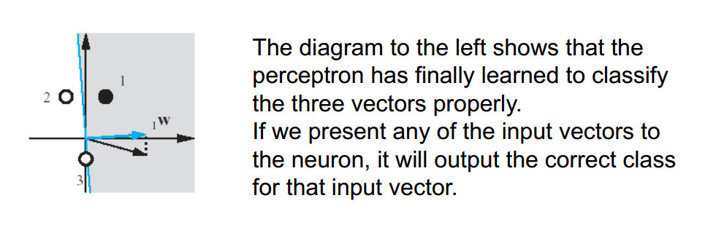
Resenblatt’s perceptron

Slide 38
Assignment I
Implement the Perceptron From Scratch

Slide 39
Agenda
Revision.
Neural Networks.
Practice.
Deep Learning.

Slide 40
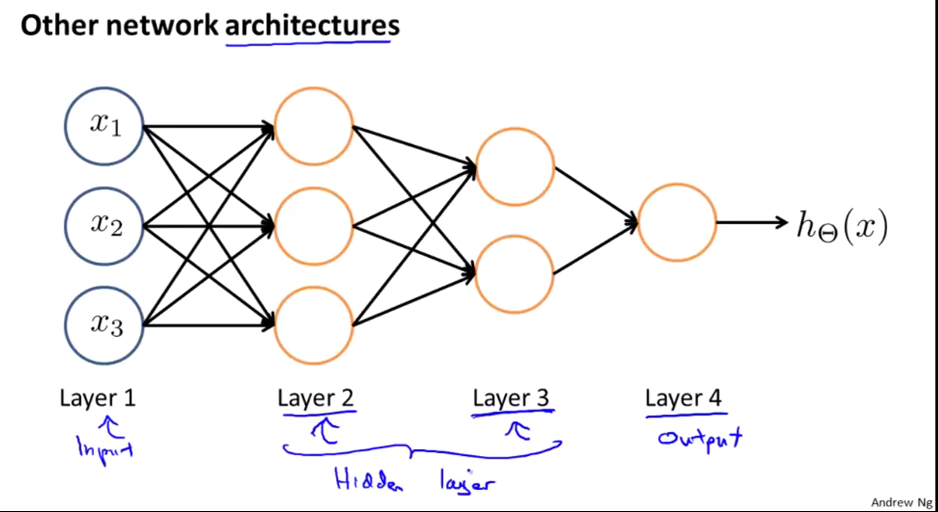
Deep Learning

Slide 41
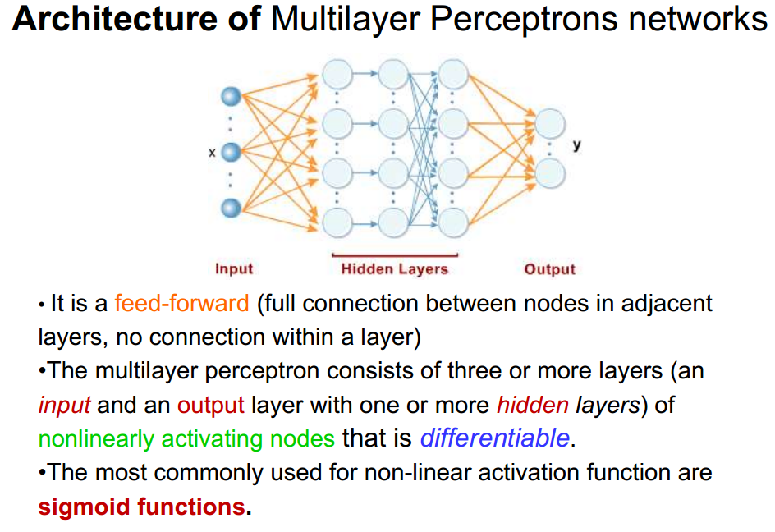
Multi-layer perceptron

Slide 42
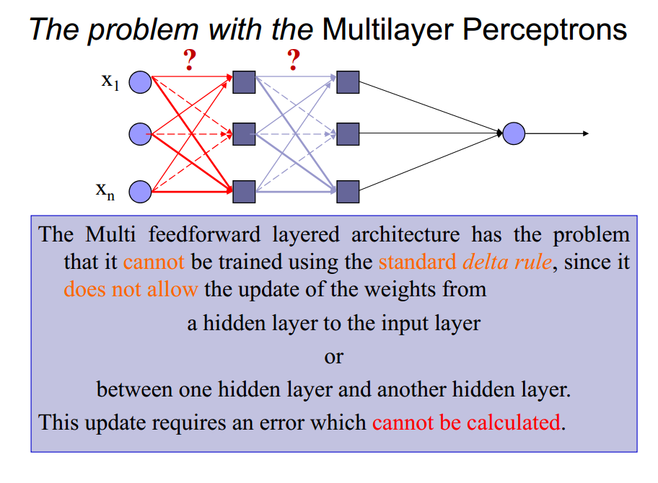
Multi-layer perceptron

Slide 43
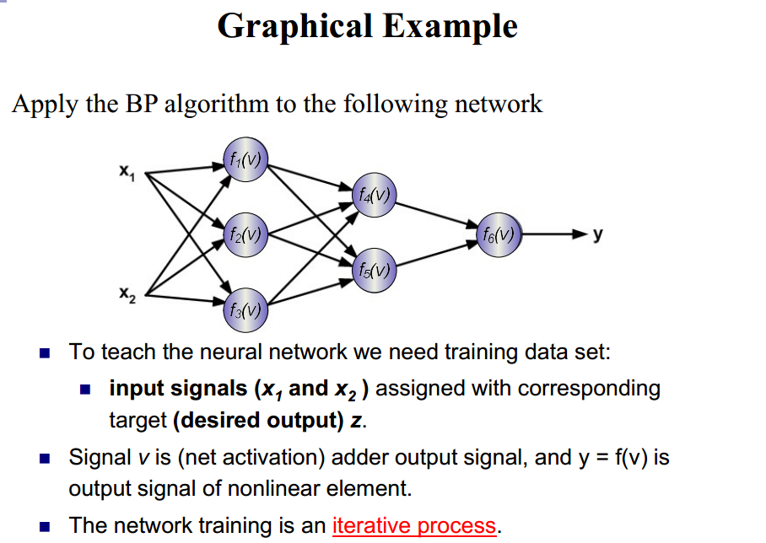
Backpropagation

Slide 44
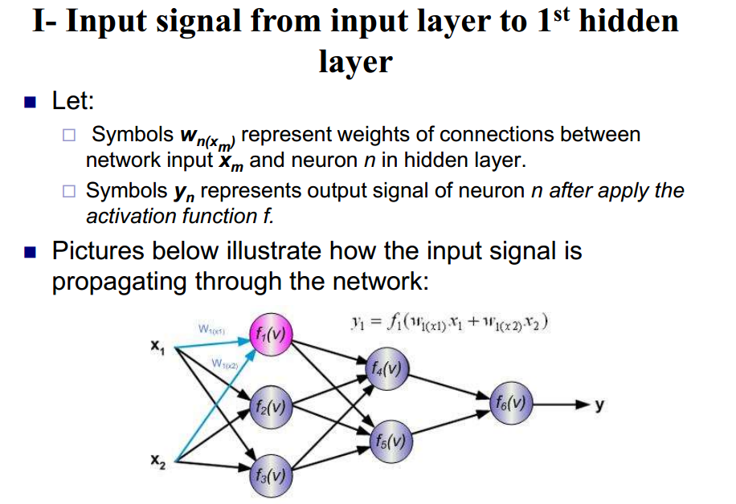
Backpropagation

Slide 45
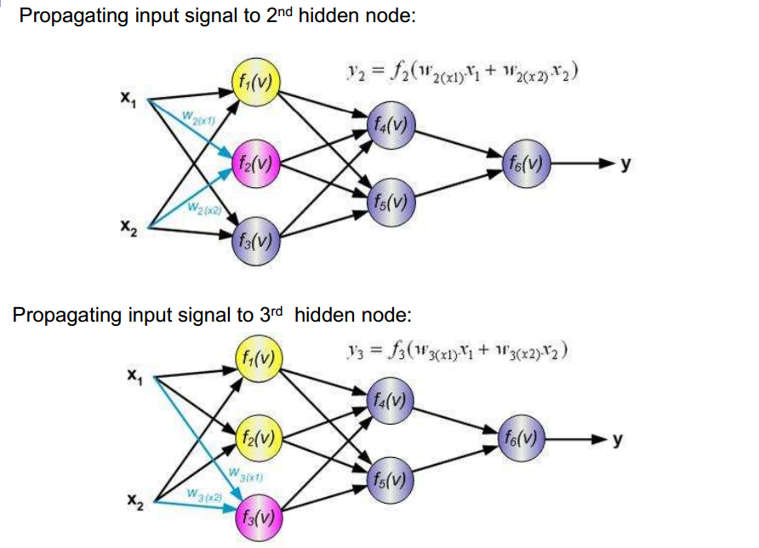
Backpropagation

Slide 46
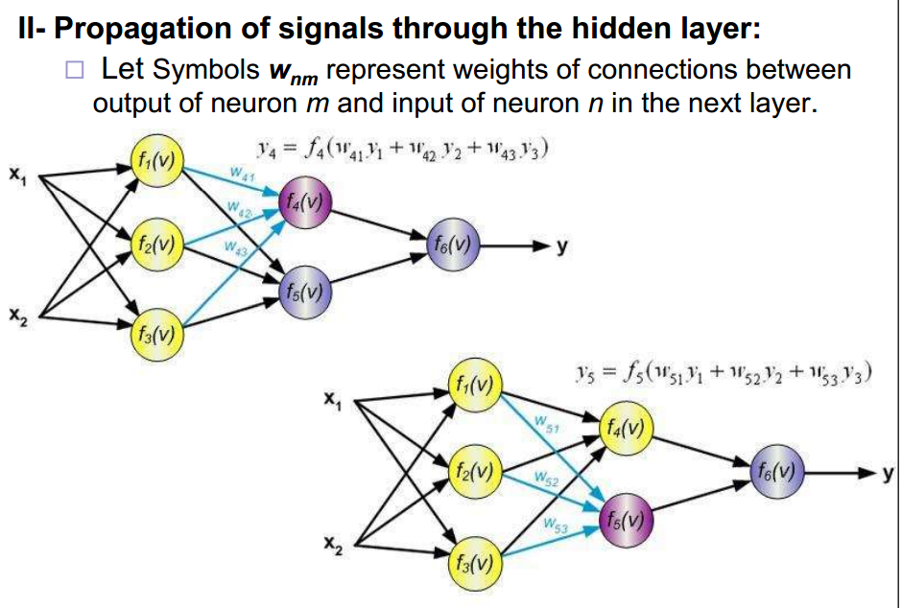
Backpropagation

Slide 47
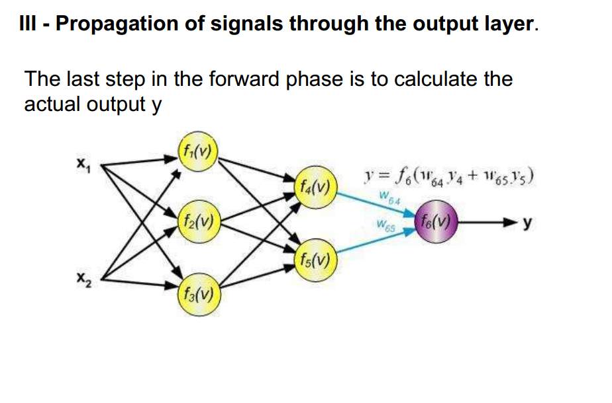
Backpropagation

Slide 48
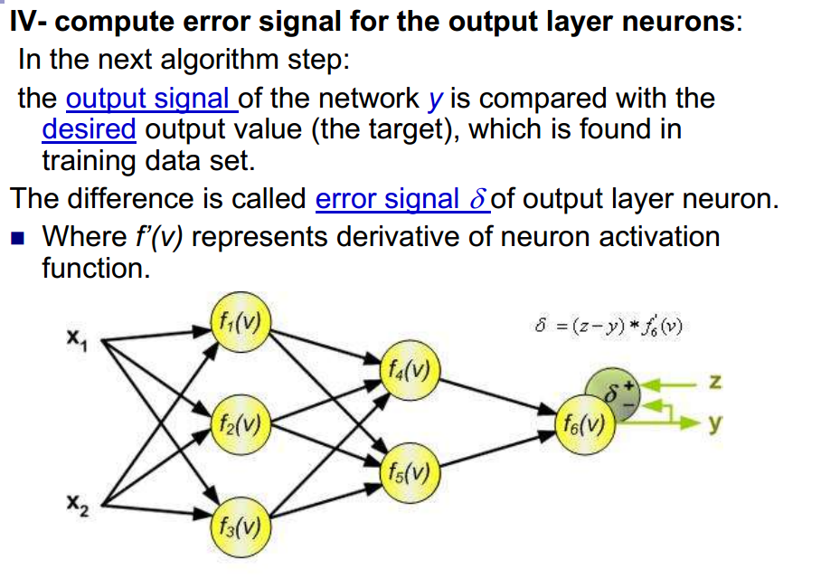
Backpropagation

Slide 49
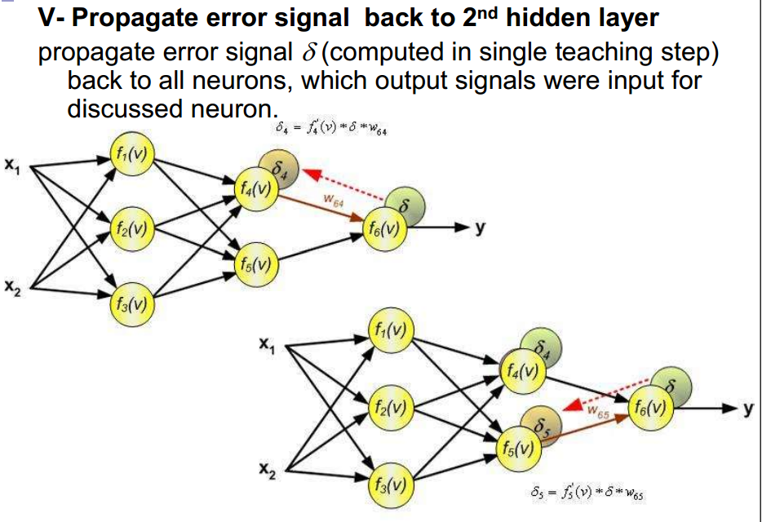
Backpropagation

Slide 50
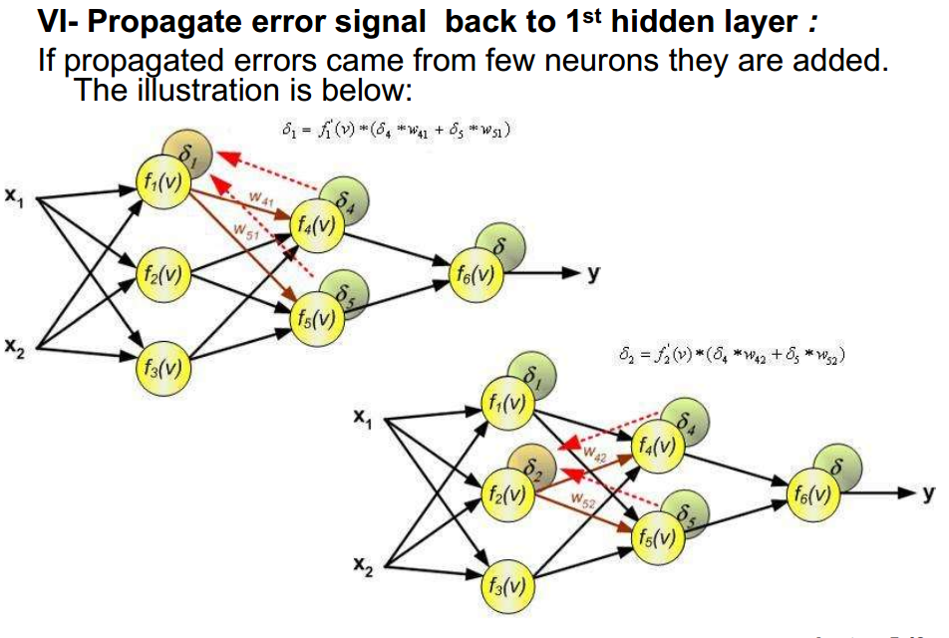
Backpropagation

Slide 51
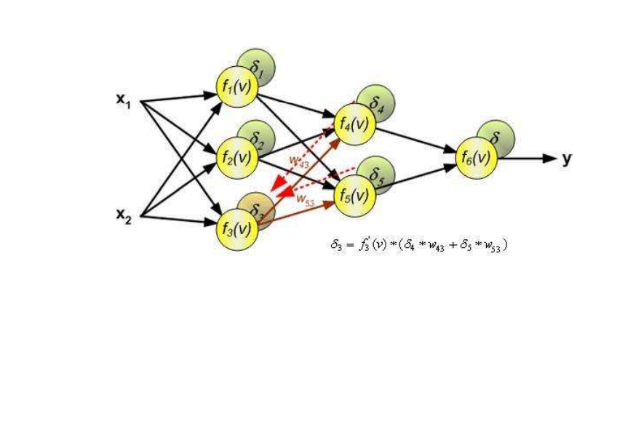
Backpropagation

Slide 52

Backpropagation

Slide 53

Backpropagation

Slide 54

Backpropagation

Slide 55

Backpropagation

Slide 56
Backpropagation
Numerical Example
(XOR)

Slide 57

Backpropagation

Slide 58

Backpropagation

Slide 59

Backpropagation

Slide 60

Backpropagation

Slide 61

Backpropagation

Slide 62

Backpropagation

Slide 63

Backpropagation

Slide 64

Backpropagation

Slide 65
Assignment II
Implement the MLP with BP From Scratch

Slide 66
Agenda
Revision.
Neural Networks.
Practice.
Deep Learning.
Practice.

Slide 67
Practice II
Handwritten digits recognition Example

Slide 68
Agenda
Revision.
Neural Networks.
Practice.
Deep Learning.
Practice.
Market – GP – ML

Slide 69
(Market || GP) && ML

